Slide 1
CRREL RAB Meeting
January 17, 2018

Slide 2
Agenda
September Meeting Minutes
Summary of synoptic soil gas sampling conducted in October 2017, comparison to previous sample rounds
Smoke testing the Main Laboratory
Healthmate shutdown pilot test
Soil vapor extraction pilot test update
Status of Feasibility Study and Engineering Evaluation/Cost Analysis reports
Public Comments
Schedule next meeting and adjourn

Slide 3
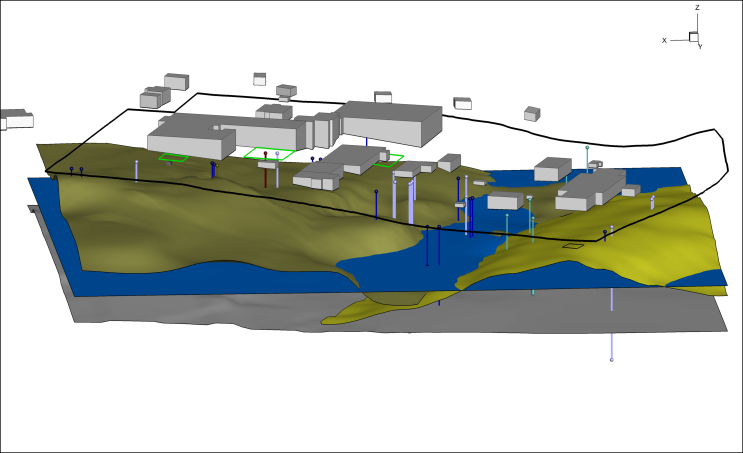
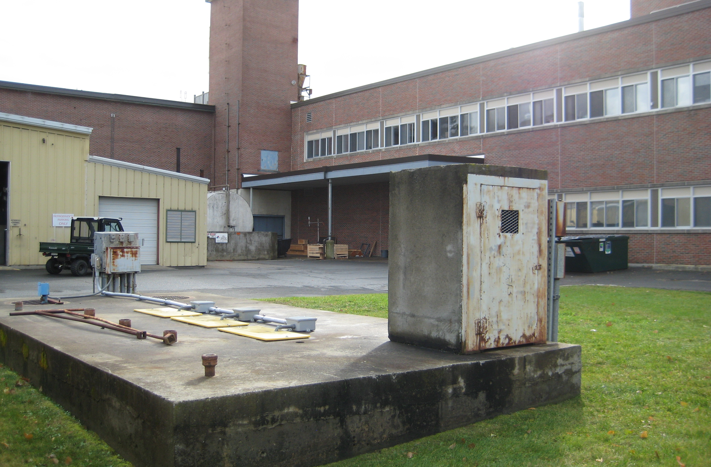
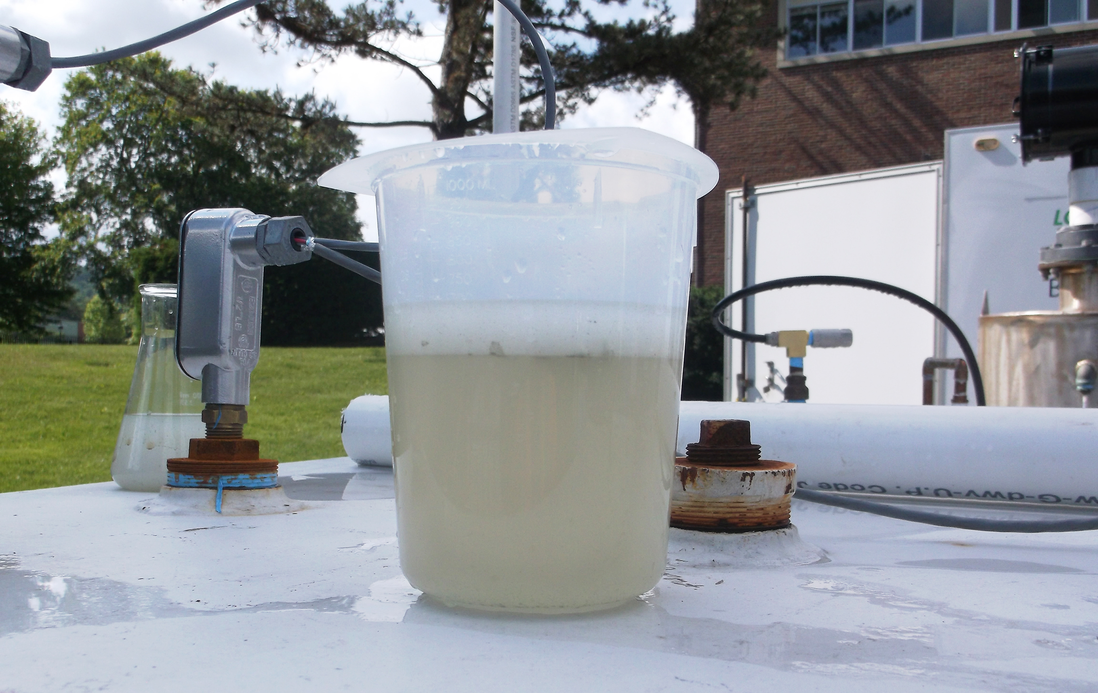
Background
TCE used extensively as a heat transfer fluid and in various experiments
TCE detected in CRREL non-contact cooling water supply wells in 1990
TCE Vapors first detected in 2010
Multiple investigations, treatment measures, removal actions
Notes:
-CRREL established in 1961… Location chosen because of the properties of the Hanover Silt.
-The cooling water is provided by 5 extraction wells within an esker
-We used the large existing historic data set to produce a comprehensive, dynamic 3D CSM. The CSM was used to look at multiple individual data sets and maybe more importantly the relationships between the data sets. The CSM was used to define data gaps and design the remedial investigation.

Slide 4
October 2017 Soil Gas Sampling
Sampling conducted from Oct 16th to Oct 19th, 2017 under rising barometer.
AOC 2 soil vapor extraction system was operating during sampling.
AOC 9 soil vapor extraction system was off for rebound evaluation.
281 soil gas samples analyzed by HAPSITE ®
147 on-property samples
134 off-property samples

Slide 5
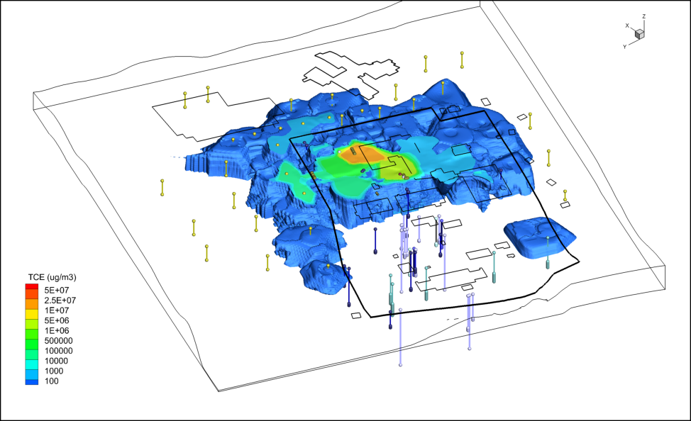
Pre-SVE Pilot Soil Gas Sampling (2012-14)

Slide 6
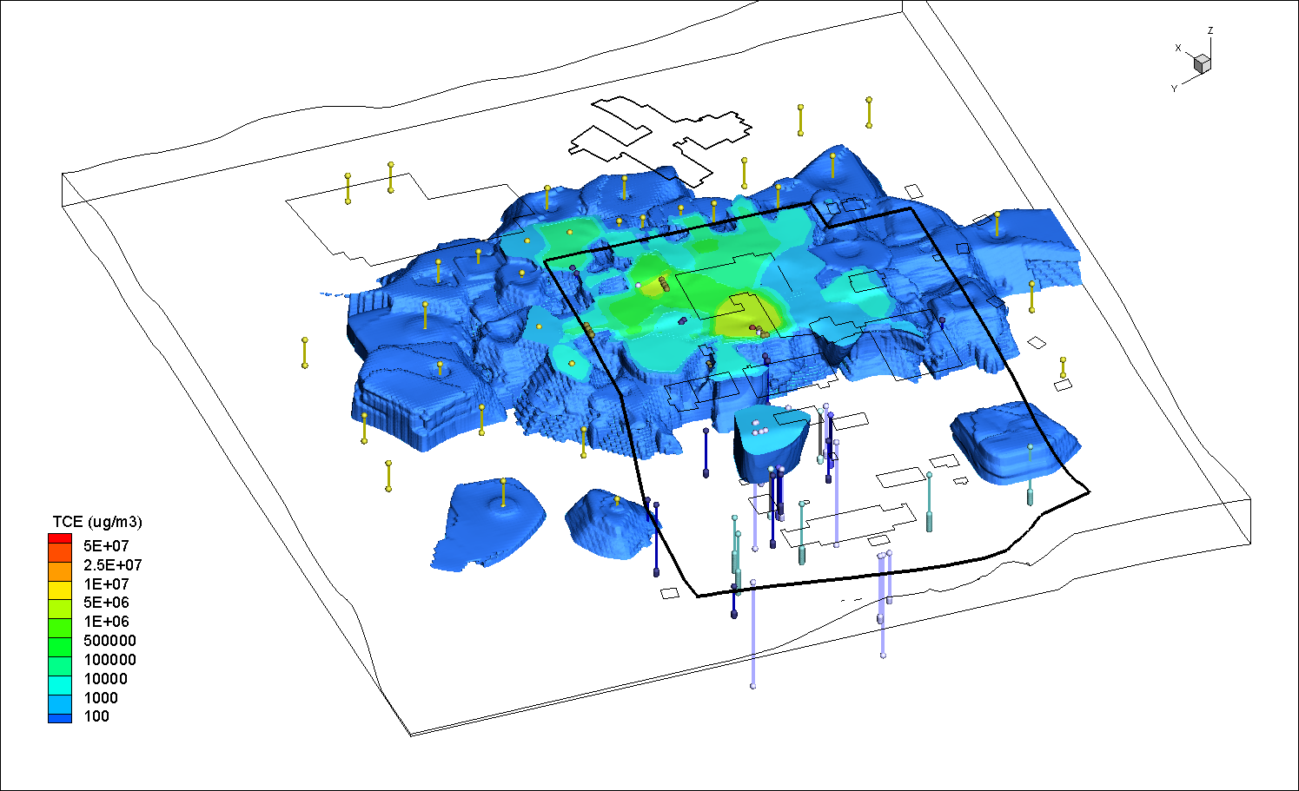
October 2015 Soil Gas Sampling (~300 gallons TCE removed from AOC 2)

Slide 7
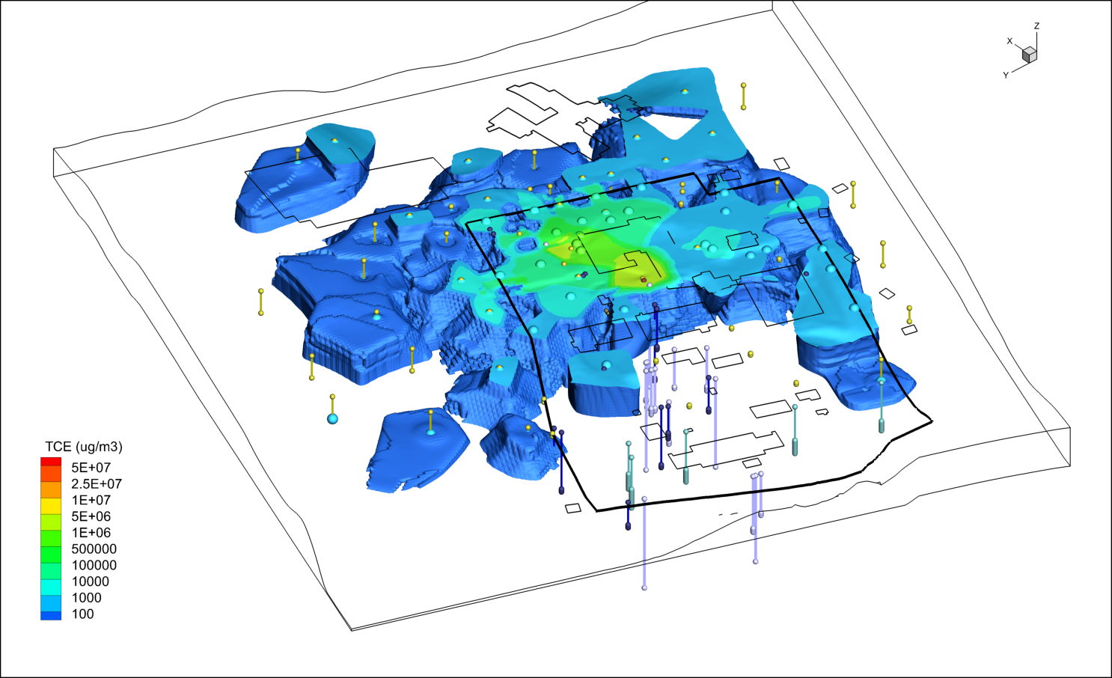
November 2016 Soil Gas Sampling (~450 gallons TCE removed from AOC 2)

Slide 8
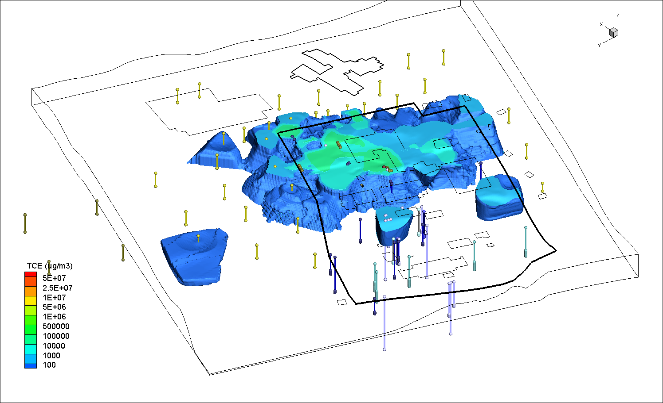
October 2017 Soil Gas Sampling (~500 gallons removed from AOC 2 and ~80 gallons from AOC 9)

Slide 9
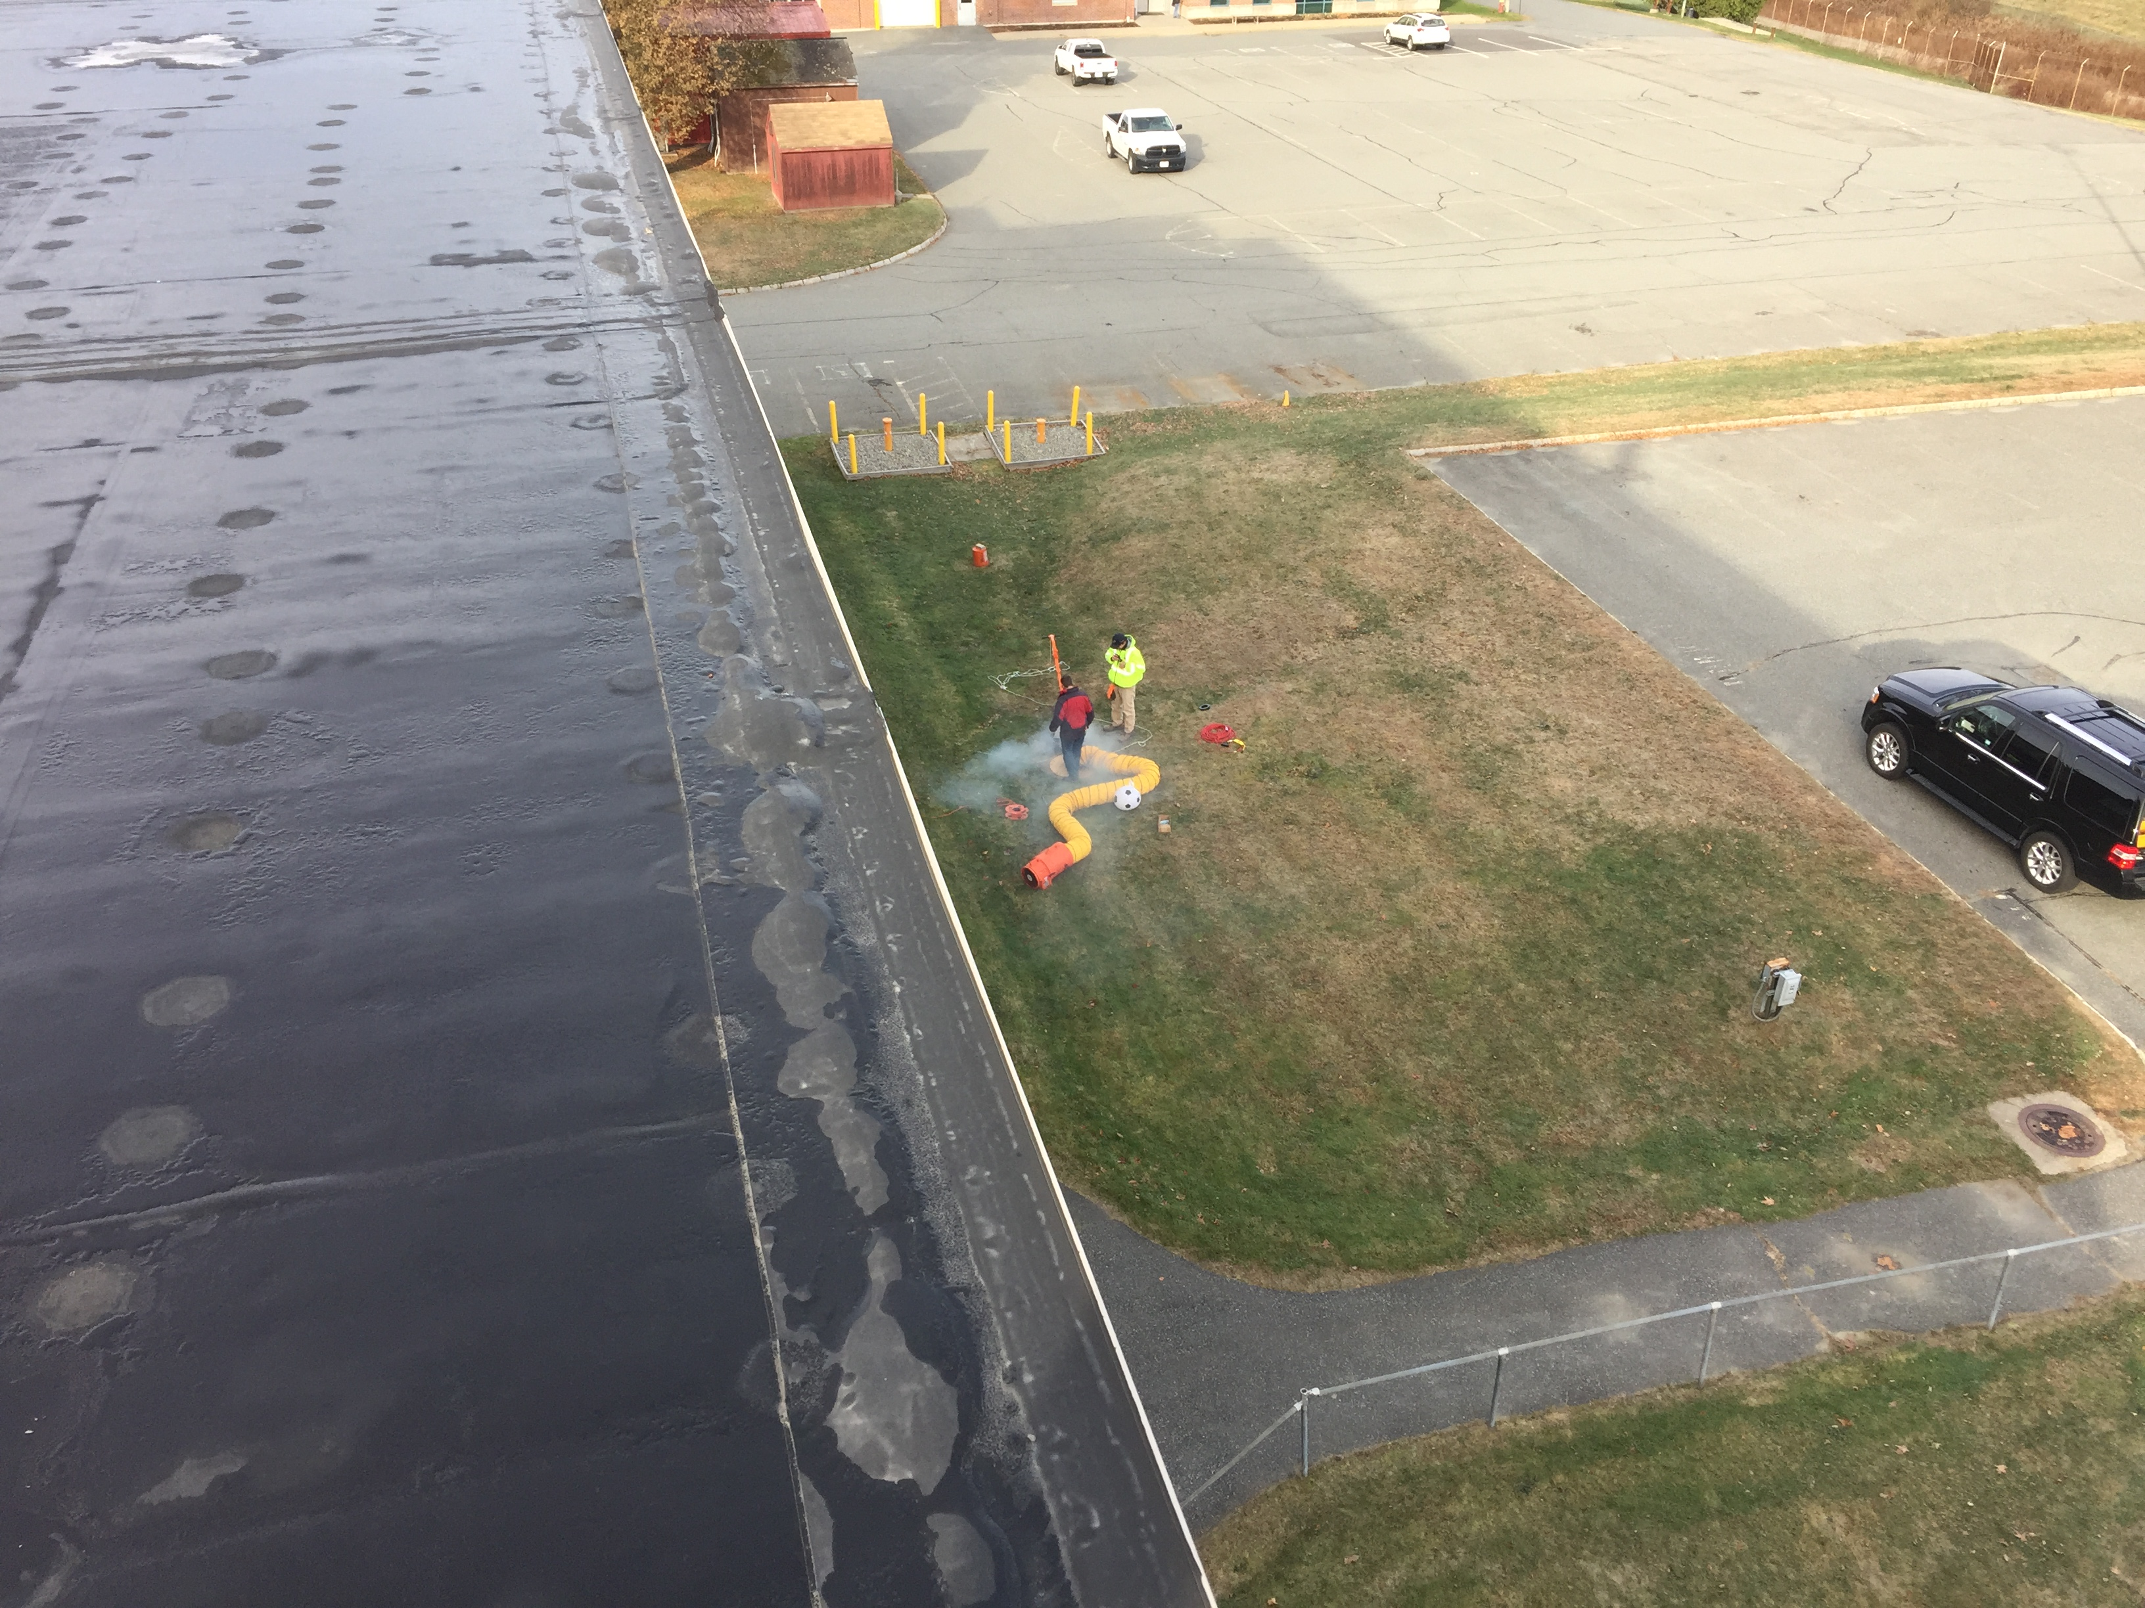
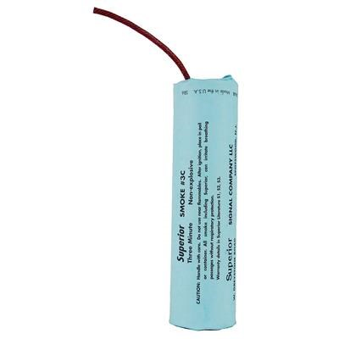
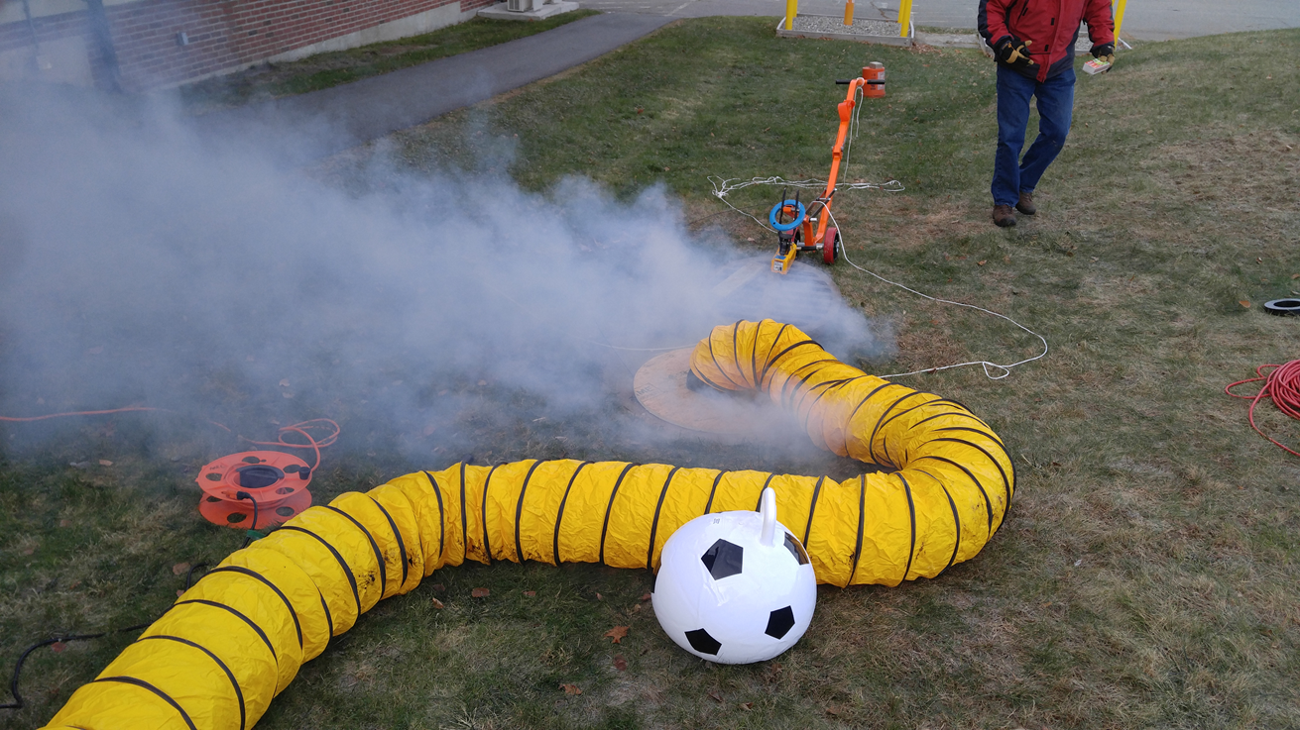
Smoke Testing of the Main Lab November 2018
Storm Drain
Sanitary Sewer

Slide 10
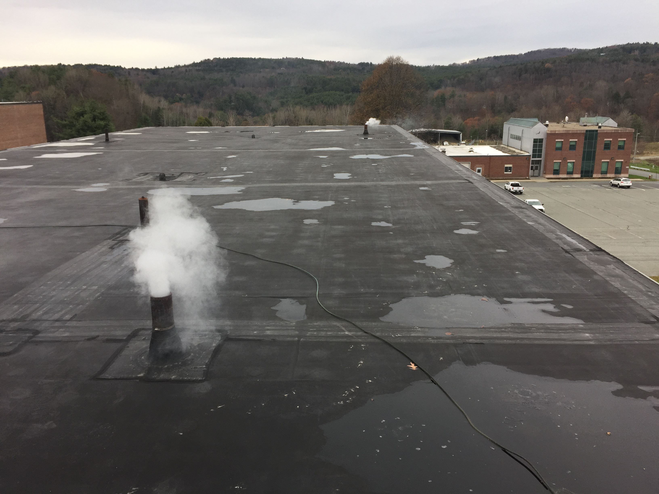
Smoke Test Objectives
Smoke an indicator of vapor intrusion pathways
Evaluate leakage from each sewer into Main Lab
Locate specific points of leakage
Evaluate if leakage contributes to elevated TCE concentration above the 2nd floor ceiling

Slide 11
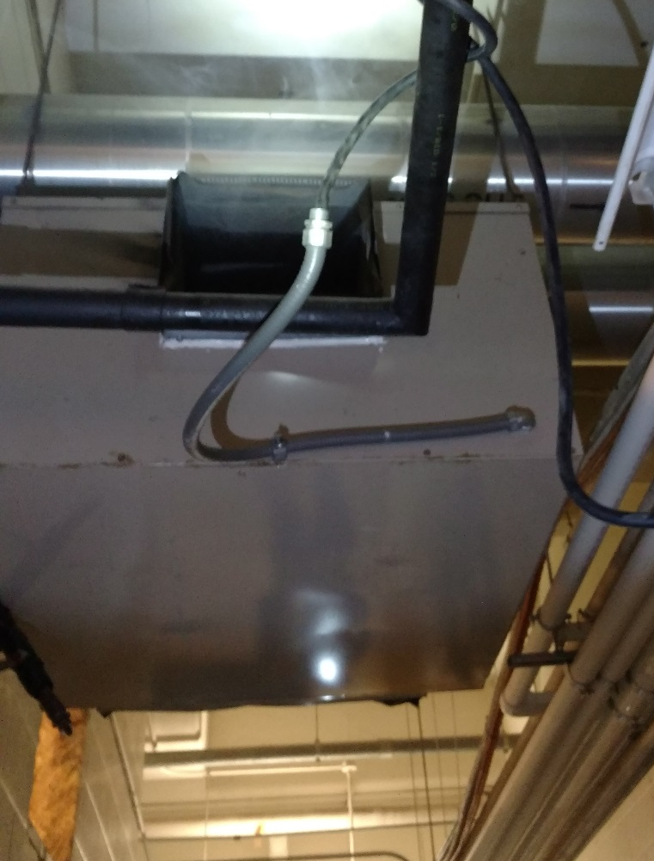
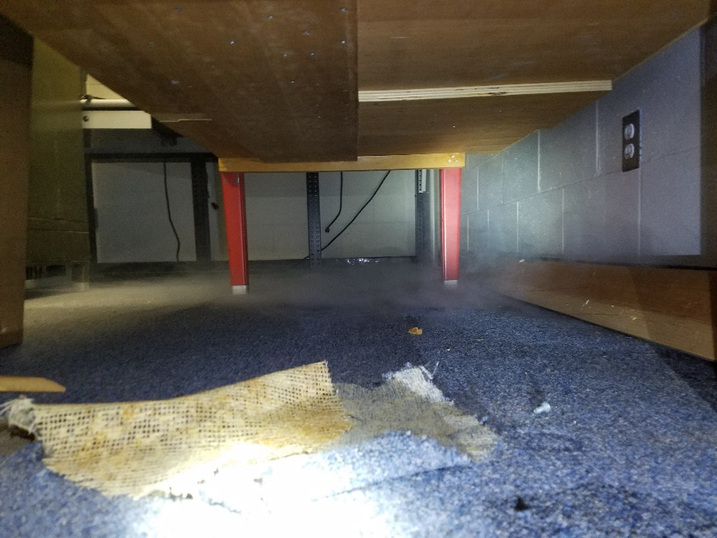
Storm Sewer Smoke Test Findings
Room 47 –abandoned, unsealed floor drain.
HVAC unit between Room 56B and 57, un-trapped condensate drain.

Slide 12
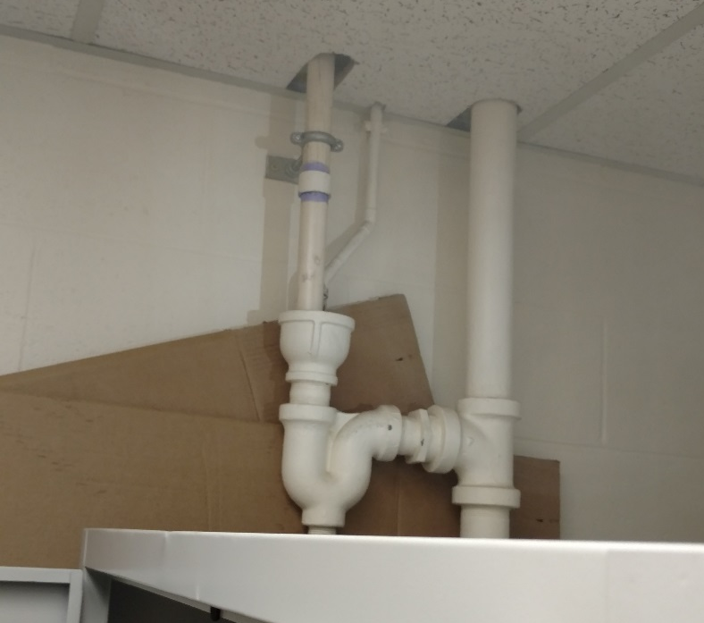
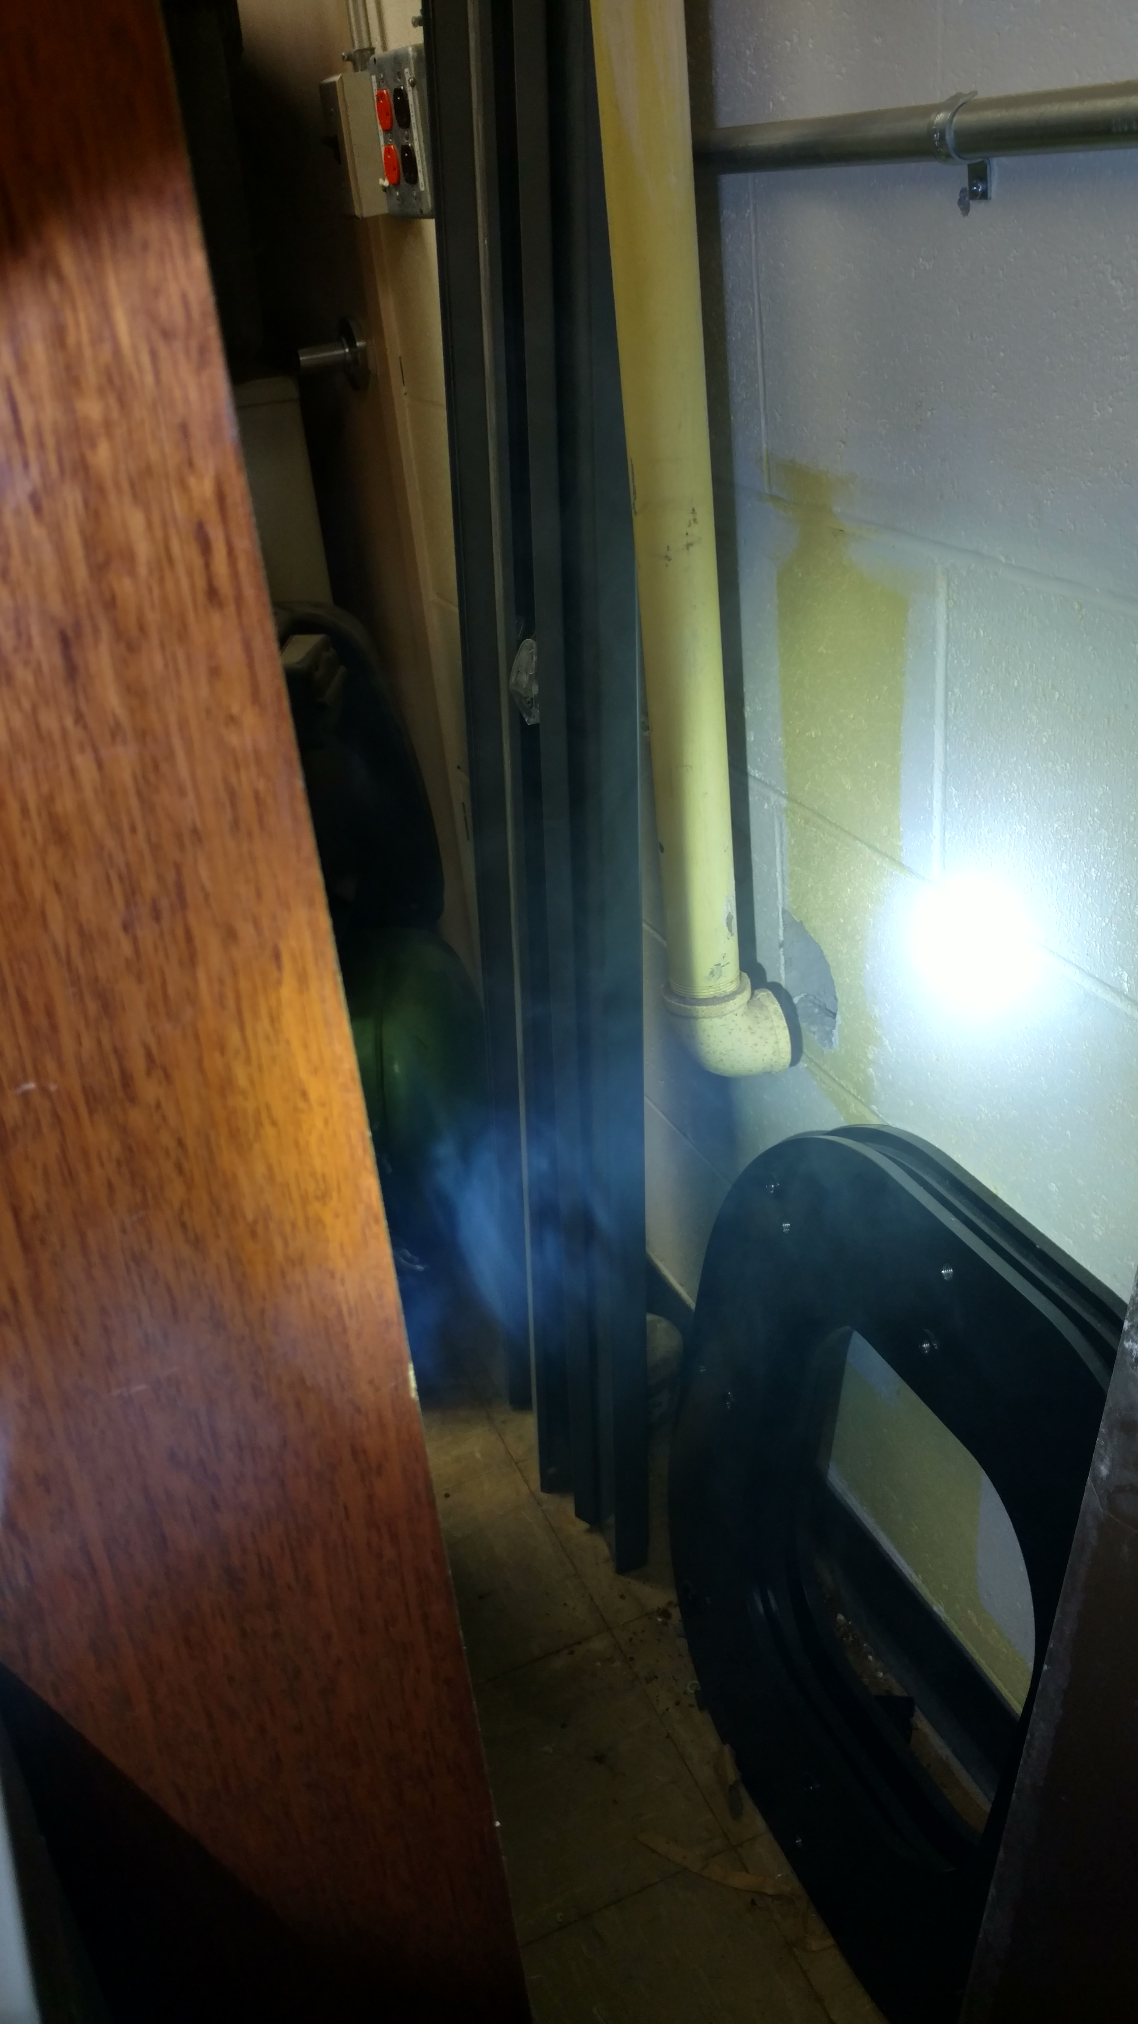
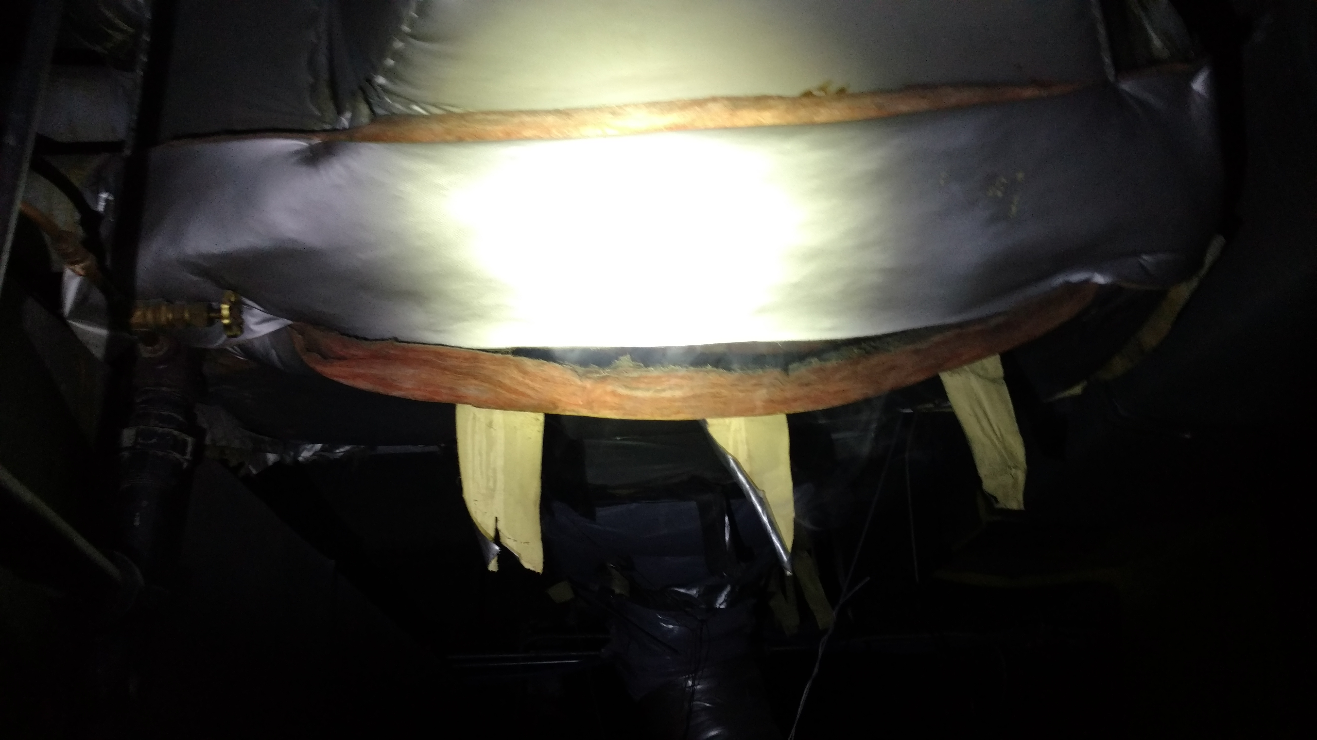
Sanitary Sewer Smoke Test Findings
Room 53 toilets
Room 46 abandoned piping
HVAC unit above Room 114
Men’s and women’s room toilets Rooms 228A and B

Slide 13
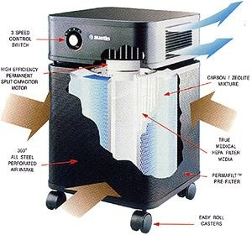
Healthmate Shutdown Pilot Test
Assess effectiveness of indoor air mitigation measures, primarily sub-slab depressurization and removal of TCE from soil gas.
Sampled indoor air with most Healthmates off over from December 20th to January 2nd.
Sub-slab depressurization systems were operating.
Soil vapor extraction systems operational up to December 28th.

Slide 14
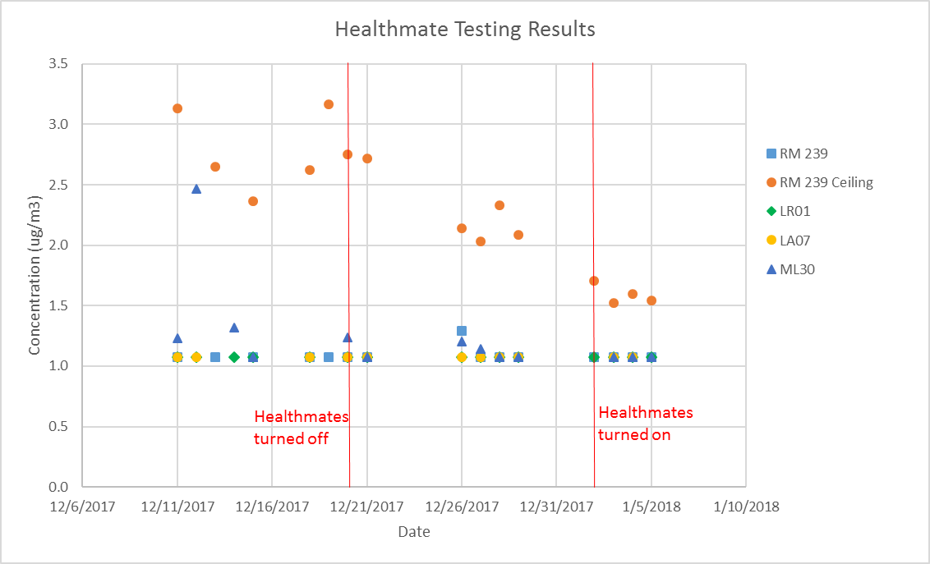

Slide 15
Soil Vapor Extraction Update
Total of ~580 gallons of TCE removed from soil gas
Systems are currently off-line due to weather
Both AOC 2 and AOC 9 are using carbon treatment systems
Observing continued decline in TCE soil vapor concentrations in both source areas and peripheral locations….. Mass Reduction.

Slide 16
What will we be working on?
Draft Feasibility Study Report
Finalize Remedial Investigation Report
Design of SVE System as Interim Measure

Slide 17
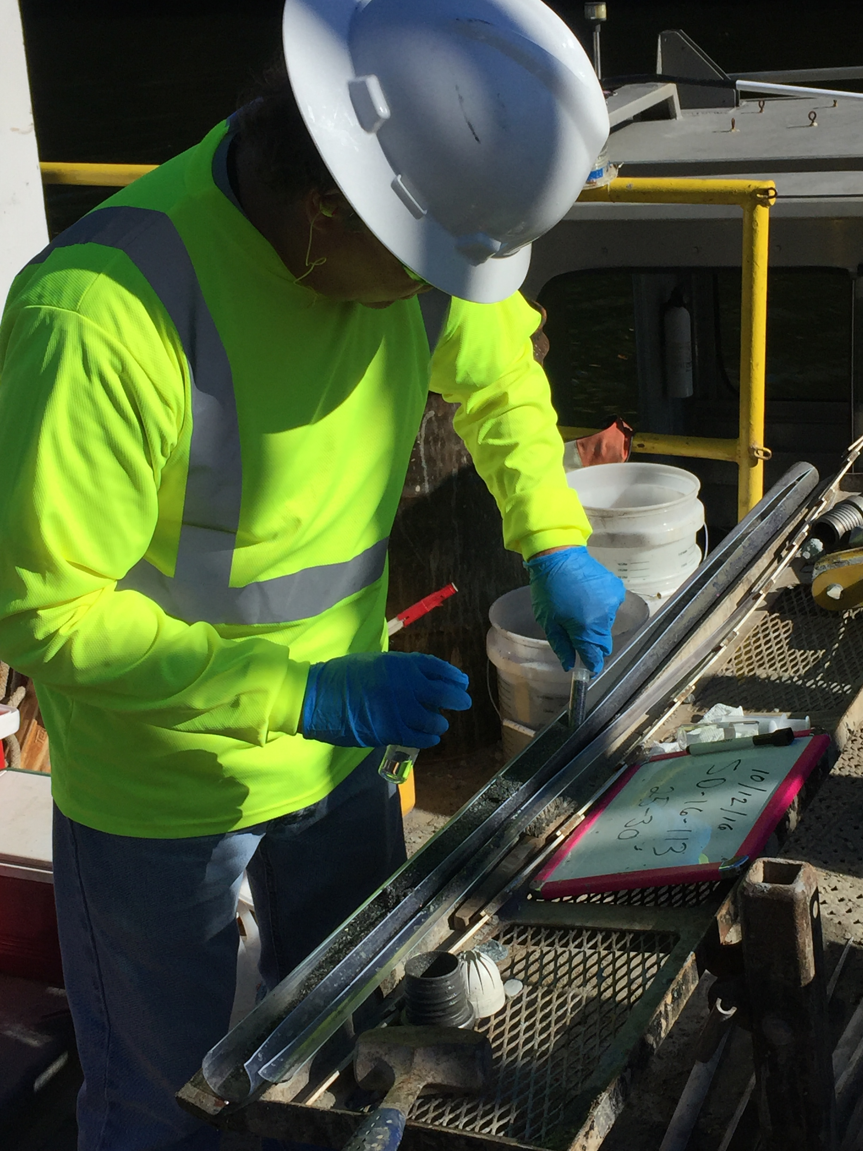
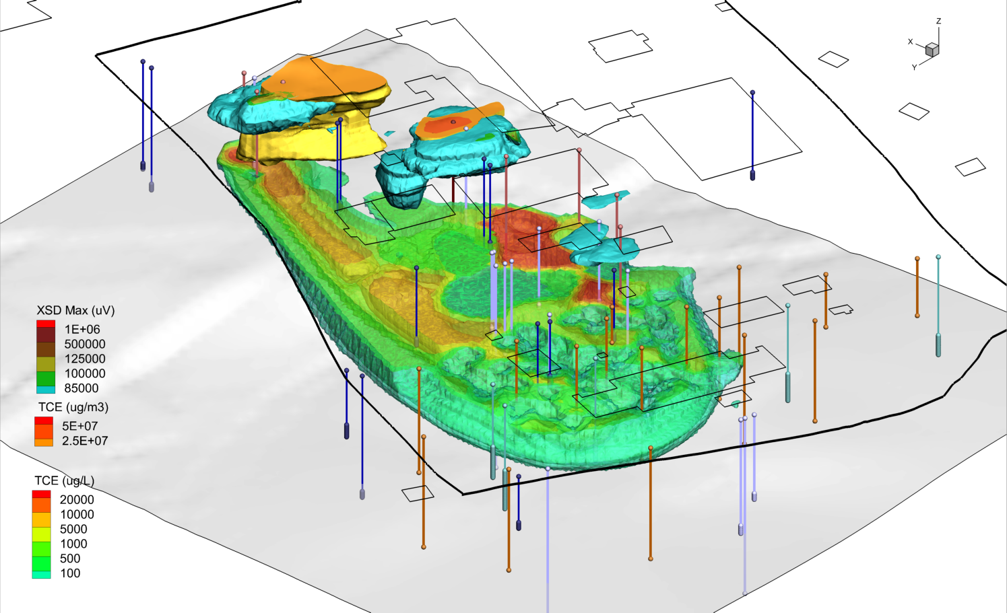
Thank You
Questions or Comments

